Slide 1
Ever Health Technology Plan
Presented by: Eagle Consulting

Slide 2
EAGLE CONSULTING ABOUT US
IT Consultancy and contracting agency for over 20 years
Founded in 1995
Goal of assisting businesses in staying up to date with the technological world around them
Acts as “Middle Man” for bringing close and personalized technology services to businesses in need

Slide 3
EAGLE CONSULTING Mission
Simple mission: stay up to date on current IT developments so that we may provide the most effective solution for your specific business needs
Aim to provide a fast, efficient, and most importantly effective IT answers
Save you time and money
Have a positive effect on the clientele you closely interact with

Slide 4
EAGLE CONSULTING Vision
Facilitate an ever increasing amount of Information Technology Solutions
Our desire is to constantly learn and develop new techniques
Aim is to be the best at understanding what makes your company special to provide the best Information Technology solution for you!

Slide 5
EVER HEALTH FITNESS
A chain of fitness centers operating nationwide 24/7
In 1973 two retired coaches, Henry Truman and Michael Hatch opened the first center in Columbus, Ohio
Prides itself not only on equipment and technology, but also an amazing atmosphere, a tradition of welcome, and unique experience found nowhere else
Their corporate location currently operates out of Columbus, Ohio

Slide 6
EVER HEALTH Mission Statement
Our goal is to provide an environment that promotes accessibility to fitness equipment and knowledge to anyone that needs it
We aim to give you the tools necessary to start and maintain a healthy lifestyle
Maintaining a comfortable and welcoming experience

Slide 7
EVER HEALTH ORGANIZATIONAL CHART
Jason Zander President & CEO
Lawrie Gaffney CFO
Patrick lliott VP Finance
Lola Jacobsen VP Accounting
Olivier Renaud Team Director
Spencer Lowe Regional Manager
Of 5 Locations
Mike Danselio Regional Manager
Of 5 Locations
Prashanth Desai Regional Manager
Of 5 Locations
Szabolcs Vajda Director of Human Resources
Jason Kozleski VP Human Resources
Pat Coleman VP Customer Svc
Gym Manager
Assistant Manager of Gym
HR representative

Slide 8
EVER HEALTH - 15 LOCATIONS
East Coast
Philadelphia, PA
Arlington, VA
Midwest
Cincinnati, OH
Detroit, MI
Columbus, OH
Milwaukee, WI Chicago, IL
Dallas, TX
Houston, TX
Tucson, AZ
West
Albuquerque, NM
Los Angeles, CA
Denver, CO
Las Vegas, NV
San Francisco, CA

Slide 9
THE PROBLEM
Ever Health Website is outdated and lacks any type of client functionality
All information is stored locally
Customers must travel to the gym location to renew or cancel their membership
Major hassles that affect customer retention rate

Slide 10
THE COST
Ability to maintain and handle member information has become increasingly haphazard
Improper charges to cancelled or duplicate members costs time and money to repair
In the past 2 years they have seen a 30% drop in customer membership renewal state-wide, resulting in a total loss of over $1,000,000
Overall customer satisfaction has decreased 20% due to difficulties signing in to gyms and customers having to deal with duplicate or misinformed records

Slide 11
THE SOLUTION/ DELIVERABLES
A centralized Database:
1.1 Shared across all gym locations
1.2 With all appropriate documentation
A redesigned and fully functional website:
2.1 Add functionality that allows customers to create, renew, update, or cancel their membership
2.2 Connected directly to the database
A Front end Interface:
3.1 Properly documented and useable by all employees
3.2 Capable of pulling and updating information from the database

Slide 12
PERIPHERAL DELIVERABLES
An accounting system capable of monitoring:
A. General Ledger
B. Accounts Receivable/Payable
C. Balance Sheet, Profit/Loss Statements
Regular updates and reports on System development
Database, website, and network systems monitoring to ensure functionality
Develop and streamline system manual/training to ensure staff learn and understand the system
Cost/Benefit Analysis
Back up and Disaster Recovery plan

Slide 13
Project Completion
Expected completion date: December 13th, 2016
Upon Completion of this project, we expect to see:
A 50% increase in overall customer satisfaction
An 80% increase in customer retention resulting in substantial financial increase and reduced cost of management. Potential to see revenue between $500,000 to $800,000
A 10% increase in Membership sign ups yearly due to website availability and customer satisfaction. Potentially 2,000 new customers bringing in $200,000 annually.
A 10% in employee efficiency due to a streamlined system

Slide 14
Project Team Roles and Responsibilities
Roney Whonshevins Project Lead
Jacob Wagner Software Developer
Adan Maxamed Software Developer
James Leahy Web Developer
Guy Banaga Network Engineer
Andrew Butts Network Engineer

Slide 15
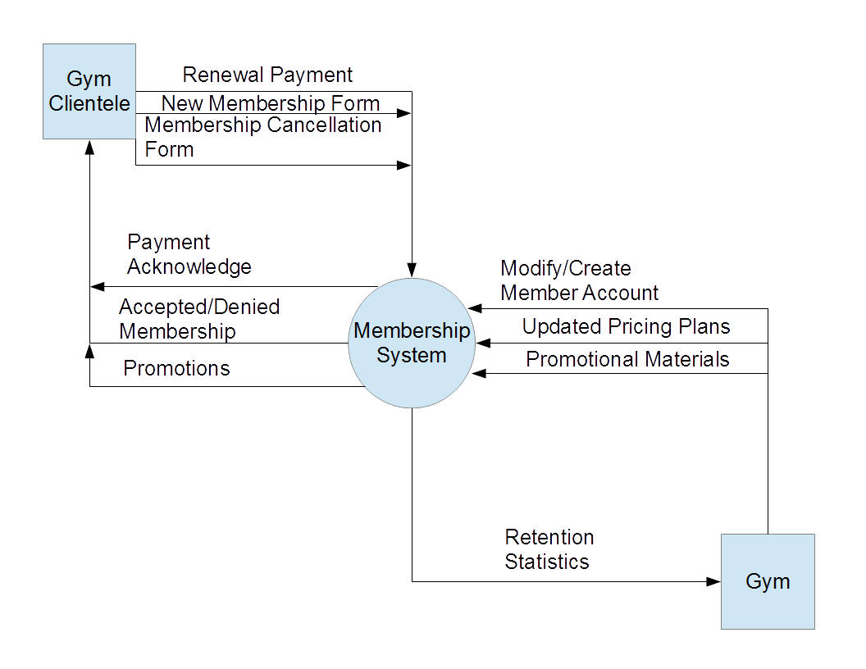
Overhead view of Implemented System
DATA BASE

Slide 16
Project Schedule

Slide 17
Eagles Consulting
10/31/2016
2016
09/11
09/18
09/25
10/02
10/09
10/16
10/23
10/30
2016
5 days
Today
System Design
9/13/16 - 9/19/16
5 days
Creation of Financial System
9/20/16 - 9/26/16
5 days
Creation of Database Sytem
9/27/16 - 10/3/16
5 days
Excell Integration
10/4/16 - 10/10/16
5 days
Business Documents
10/11/16 - 10/17/16
5 days
Advertising Materials
10/18/16 - 10/24/16
5 days
Website Development
10/25/16 - 10/31/16

Slide 18
5 days
Report Creation
11/1/16 - 11/7/16
5 days
System Testing
11/8/16 - 11/14/16
5 days
Training
11/15/16 - 11/21/16
5 days
System Development Part 1
11/22/16 - 11/28/16
5 days
System Development Part 2
11/29/16 - 12/5/16
5 days
System Development Part 3
12/6/16 - 12/12/16
1 day
Presentation
12/13/16
Eagles Consulting
12/12/2016
2016
10/30
11/06
11/13
11/20
11/27
12/04
12/11
2016
Today

Slide 19
Timeline: 9/13/2016 - 12/12/2016
Milestone(s)
Date | Description
12/12/2016 | Eagles Consulting
Task(s)
Duration (days) | Start Date | End Date | Description
7 | 09/13/2016 | 09/19/2016 | System Design
7 | 09/20/2016 | 09/26/2016 | Creation of Financial System
7 | 09/27/2016 | 10/03/2016 | Creation of Database Sytem
7 | 10/04/2016 | 10/10/2016 | Excell Integration
7 | 10/11/2016 | 10/17/2016 | Business Documents
7 | 10/18/2016 | 10/24/2016 | Advertising Materials
7 | 10/25/2016 | 10/31/2016 | Website Development
7 | 11/01/2016 | 11/07/2016 | Report Creation
7 | 11/08/2016 | 11/14/2016 | System Testing
7 | 11/15/2016 | 11/21/2016 | Training
7 | 11/22/2016 | 11/28/2016 | System Development Part 1
7 | 11/29/2016 | 12/05/2016 | System Development Part 2
7 | 12/06/2016 | 12/12/2016 | System Development Part 3
1 | 12/13/2016 | 12/13/2016 | Presentation

